Slide 1

Cyber Security

Slide 2
What are the Threats?
Q: What's the biggest cyber threat facing America today? Organized terrorism, or a bored, curious kid?
FBI: At this point it is difficult to quantify since computer intrusions occur daily originating from several sources. The origination of these intrusions and the intent of the intruders is often not obvious.
These threats come in the form of:
Computer Intrusion (hacking-passive or active)
Denial of service attacks (DOS)
Virus & Worms deployment.

Slide 3
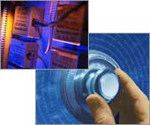
State of the Industry
According to the 2003 Computer Security Institute and FBI annual study on security, 95% of respondents detected computer security breaches in the last 12 months.
Companies will spend nearly $24 Billion on network security in 2004 and it is expected this amount could triple in the next two years.

Slide 4
Clean up cost of Cyber-attacks
  SirCam: 2.3 million computers affected
    –Clean-up: $460 million
    –Lost productivity: $757 million
  Code Red: 1 million computers affected
    –Clean-up: $1.1 billion
    –Lost productivity: $1.5 billion
  Love Bug: 50 variants, 40 million computers affected
    –$8.7 billion for clean-up and lost productivity
  Nimda
    –Cost still to be determined

Slide 5




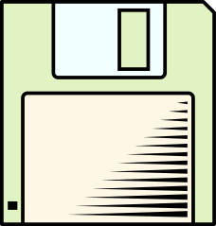
Trojan Horse Attack
Trojan Horse is activated when the software or attachment is executed.
Trojan Horse releases virus, monitors computer activity, installs backdoor, or transmits information to hacker.
Trojan Horse arrives via email or software like free games.

Slide 6
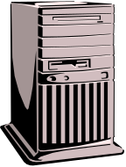
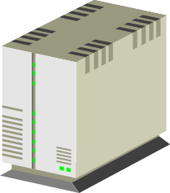
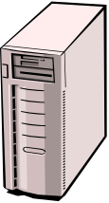
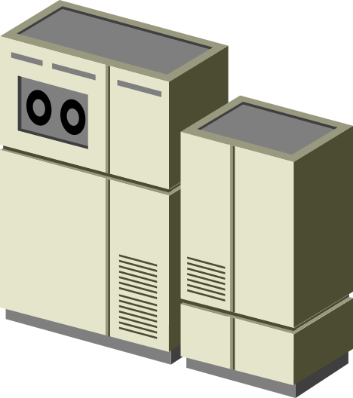
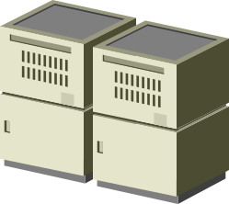
Denial of Service Attacks
In a denial of service attack, a hacker compromises a system and uses that system to attack the target computer, flooding it with more requests for services than the target can handle. In a distributed denial of service attack, hundreds of computers (known as a zombies) are compromised, loaded with DOS attack software and then remotely activated by the hacker.

Slide 7
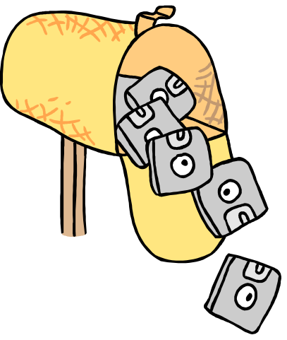
Spamming Attacks
Sending out e-mail messages in bulk. It’s electronic “junk mail.”
Spamming can leave the information system vulnerable to overload.
Less destructive, used extensively for e-marketing purposes.

Slide 8
What Does it Mean- “Security”?
“Security” is the quality or state of being secure--to be free from danger. But what are the types of security we have to be concern with?
Physical security - addresses the issues necessary to protect the physical items, objects or areas of an organization from unauthorized access and misuse.
Personal security - addresses the protection of the individual or group of individuals who are authorized to access the organization and its operations.
Operations security- protection of the details of a particular operation or series of activities.

Slide 9
What Does it Mean- “Security”?
Communications security - concerned with the protection of an organization’s communications media, technology, and content.
Network security is the protection of networking components, connections, and contents.
Information Security – protection of information and its critical elements, including the systems and hardware that use, store, or transmit that information.

Slide 10
The Need for Security
Industry Need for Information Security
An organization needs information security for four important reasons:
1. To protect the organization’s ability to function,
2. To enable the safe operation of applications implemented on the organization’s IT systems,
3. To protect the data the organization collects and uses, and
4. To safeguard the technology assets in use at the organization.

Slide 11
Information Security Threats
Act of Human Error or Failure (accidents, mistakes)
Compromises to Intellectual Property (piracy, copyright infringement)
Acts of Espionage or Trespass (unauthorized access and/or data collection)
Acts of Information Extortion (blackmail of information disclosure)
Acts of Sabotage or Vandalism (destruction of systems or information)
Software Attacks (viruses, worms, macros, denial of service)

Slide 12
Information Security Threats
Forces of Nature (fire, flood, earthquake, lightning)
Quality of Service Deviations from Service Providers (power & WAN service issues)
Technical Hardware Failures or Errors (equipment failure)
Technical Software Failures or Errors (bugs, code problems, unknown loopholes)
Technological Obsolescence (antiquated or outdated technologies)

Slide 13
Acts of Human Error or Failure

Slide 14
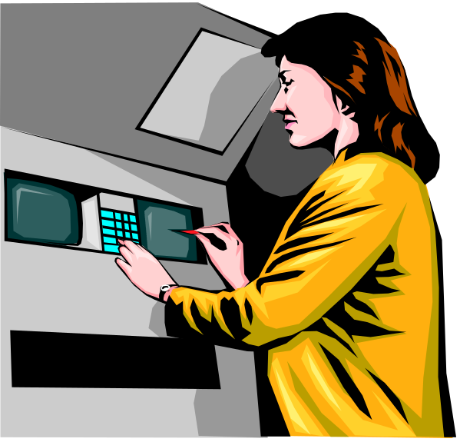
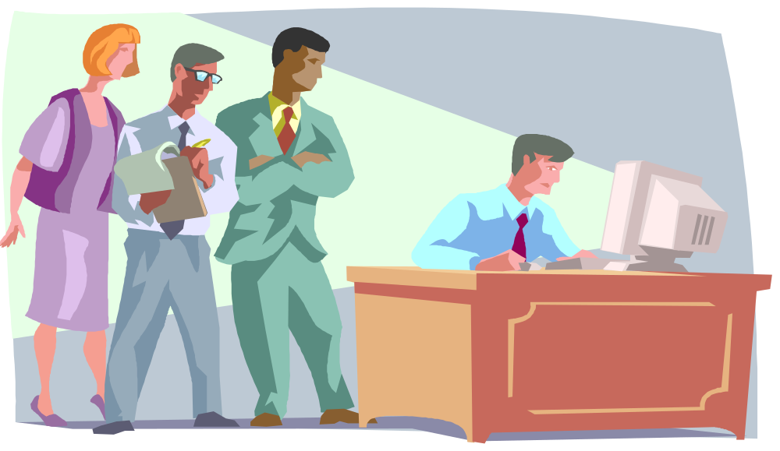
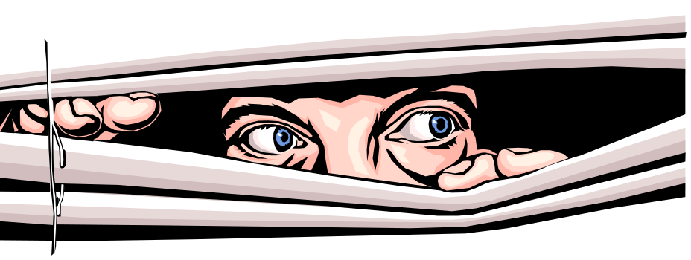
Shoulder surfing takes many forms.
Some may not be obvious.

Slide 15
?
Modern Hacker Profile:
“age 12-60, male or female, unknown background, with varying technological skill levels. May be internal or external to the organization”
Traditional Hacker Profile*:
“juvenile, male, delinquent, computer genius”
*Source: Parker, D. B. Fighting Computer Crime, Wiley, 1998.

Slide 16
Information Security
Tools, such as policy, awareness, training, education, and technology are necessary for the successful application of information security.
The NSTISSC (National Security Telecommunications and Information Systems Security Committee) model of information security is known as the C.I.A. triangle (Confidentiality, Integrity, and Availability) – these are characteristics that describe the utility/value of information

Slide 17
Figure 3
C.I.A. TRIANGLE
Confidentiality
INFORMATION
Integrity Availability

Slide 18
The Dilemma of Security
The problem that we cannot get away from in computer security is that we can only have good security if everyone understands what security means, and agrees with the need for security.
Security is a social problem, because it has no meaning until a person defines what it means to them.
The harsh reality is the following: In practice, most users have little or no understanding of security. This is our biggest security hole.

Slide 19
Meaning of Security Lies in Trust
Every security problem has this question it needs to answer first: Whom or what do we trust?
On our daily lives, we placed some sort of technology between us and the “things” we don’t trust. For example lock the car, set the house alarm, give Credit Card number only to the cashier, etc.
So we decided to trust somebody/something to have some sort of security (trust the lock, trust the police, trust the cashier).
We have to have the same scenario for computer & network systems we use today.

Slide 20
Components of an
Information System
People are the biggest threat to information security!!! (WHY? – Because WE are the weakest link)
Social Engineering . It is a system that manipulates the actions of people in order to obtain information about a system in order to obtain access.
Procedures are written blueprints for accomplishing a specific task; step-by-step descriptions.
The obtainment of the procedures by an unauthorized user would constitute a threat to the integrity of the information.

Slide 21



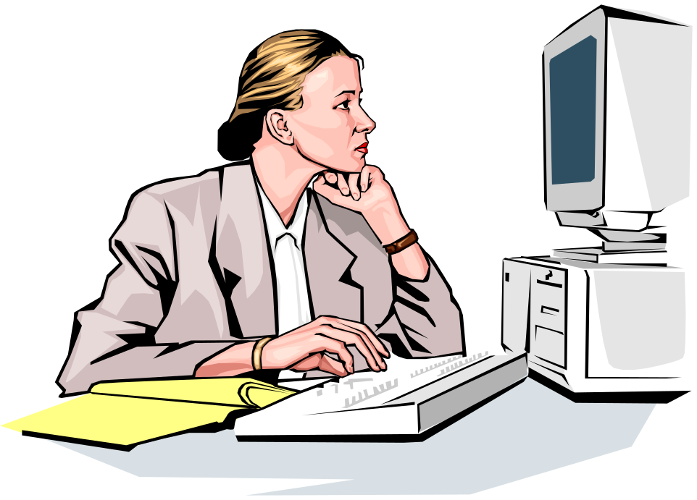

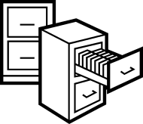
Figure 5
Hardware
Software
People
Procedures
Data
Components of an Information System

Slide 22
Figure 6
Internet
Computer as Subject of Crime
Computer as Object of Crime
Remote System
Hacker

Slide 23
Access vs. Security
When considering security it is important to realize that it is impossible to obtain perfect security. Security is not an absolute. Instead security should be considered a balance between protection and availability.
It is possible to have unrestricted access to a system, so that the system is available to anyone, anywhere, anytime, through any means. However, this kind of random access poses a danger to the integrity of information.
On the other hand complete security of an information system would not allow anyone access at any given time.

Slide 24
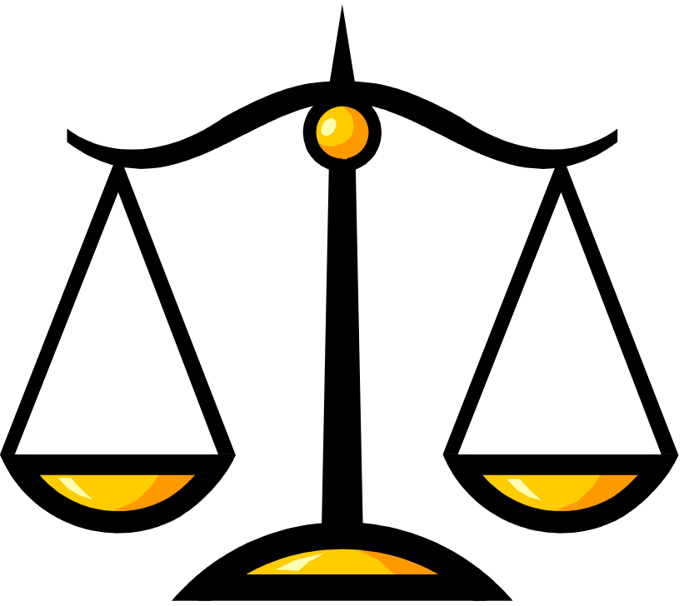
Figure 7
Security Access
Balancing Security and Access- Too much security might make access hard to get and people will stop using the system. On the other hand, a too easy access protocol, might be a security hole for the network. A balance must be achieved between those two major “players”

Slide 25
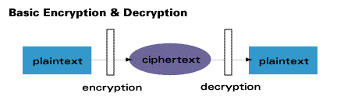

What is Encryption ?
Encryption is the process of converting messages, information, or data into a form unreadable by anyone except the intended recipient. As shown in the figure below, Encrypted data must be deciphered, or decrypted, before it can be read by the recipient.
The root of the word encryption—crypt—comes from the Greek word kryptos, meaning hidden or secret.

Slide 26
History of Cryptography
1900 BC: A scribe in Egypt uses a derivation of the standard hieroglyphics
ABCDEFGHIJKLMNOPQRSTUVWXYZ
ZYXWVUTSRQPONMLKJIHGFEDCBA
Figure 1: ATBASH Cipher
100-44 BC: Julius Caesar uses a simple substitution with the normal alphabet in government communications.
ABCDEFGHIJKLMNOPQRSTUVWXYZ
DEFGHIJKLMNOPQRSTUVWXYZABC
Figure 2: Caesar Cypher

Slide 27
History of Cryptography
In 1518 Johannes Trithemius wrote the first printed book on cryptology. It was also known as changing key cipher.
    ABCDEFGHIJKLMNOPQRSTUVWXYZ Plaintext
    FGUQHXSZACNDMRTVWEJBLIKPYO T00
    OFGUQHXSZACNDMRTVWEJBLIKPY T01
    YOFGUQHXSZACNDMRTVWEJBLIKP T02
    PYOFGUQHXSZACNDMRTVWEJBLIK T03
    ...
    GUQHXSZACNDMRTVWEJBLIKPYOF T25
    Figure 3: Changing Key Cipher

Slide 28
History of Cryptography
1790: Thomas Jefferson invented the wheel cipher
    GJTXUVWCHYIZKLNMARBFDOESQP
    W1
    IKMNQLPBYFCWEDXGZAJHURSTOV
    W2
    HJLIKNXWCGBDSRVUEOFYPAMQZT
    W3
    ...
    BDFONGHJIKLSTVUWMYEPRQXZAC
    Wn
Figure 4: A Wheel Cipher

Slide 29
Modern Encryption Algorithms
Private Key Encryption
Public Key Encryption
Quantum Cryptography

Slide 30
Private Key Algorithms
Private key encryption algorithms use a single key for both encryption and decryption. In order to communicate using this class of ciphers, the key must be known to both sender and receiver of the message.

Slide 31
Public Key Algorithms
Public key methods require two unique keys per user; one called the public key, and the other called the private key.
The private key is mathematically linked to the public key. While public keys are published, private keys are never exchanged and always kept secret.

Slide 32
Mathematical Basis of
Public Key Algorithms
Factoring of large integers
  RSA Algorithm
Discrete Log Problem
  DSA Algorithm

Slide 33
Quantum Cryptography
Method of secure key exchange over an insecure channel based on the nature of photons
Polarized photons are transmitted between sender and receiver to create a random string of numbers, the quantum cryptographic key
Perfect encryption for the 21st century
Experimental stages
Very secure

Slide 34
Modern Encryption Methods and Authentication Devices
Cryptographic Accelerators
Authentication Tokens
Biometric/Recognition Methods

Slide 35
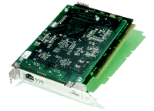

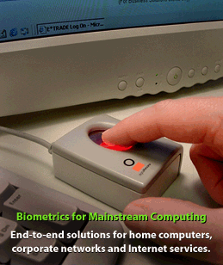
Examples
Type | Cryptographic Accelerator | Authentication Token | Biometric/ Recognition
Definition | Coprocessor that calculates and handles the Random Number Generation | External device that interfaces with device to grant access. 2 types: contact and NonContact | External device that measures human body factors to allow access
Examples | PCI coprocessor | Credit Card, RSA SecurID | Fingerprint, Optical, Voice and Signature recognition

Slide 36
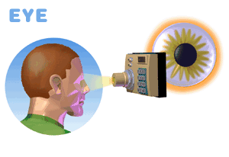
Biometrics Devices
The iris of your eye is the colored part that surrounds your black pupil, the black part. Every iris is different. If a scan of a user’s iris matches the one in the security system’s memory, access is allowed.

Slide 37
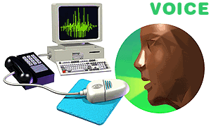
Biometrics Devices
Another trait unique to every individual is his or her voice. The user speaks a specified word or sentence to gain access to a secured computer. Distinct patterns, tones, and other qualities in the voice must match the authorized user’s voice in the computer’s security system.

Slide 38
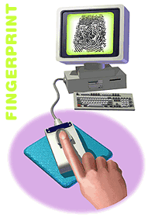
Biometrics Devices
Another biometric option is the fingerprint and its unique identifying characteristics. Placed on a special reading pad, a designated finger’s print is recognized by a computer. A similar biometric device scans a person’s whole hand

Slide 39
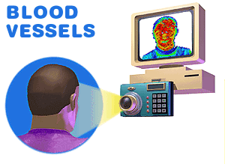
Biometrics Devices
The blood vessels in a person’s face radiate heat. The patterns of those vessels, and the heat scan, are completely individual and could be recognized and required for computer access.

Slide 40
Active in Internet Start-Ups
Finland
Japan
France
Denmark
Germany
UK
Italy
Israel
Canada
US
0 2 4 6 8 10%

Slide 41
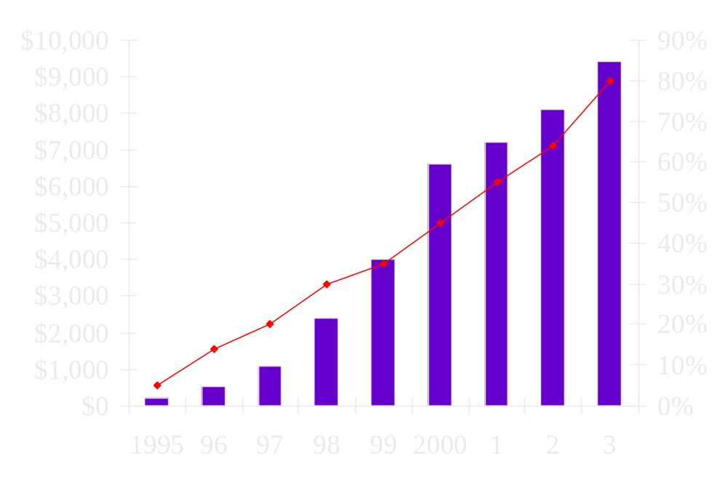
USA On-Line Shopping Revenues
$ x Millions
Web
Users
Forrester Research

Slide 42
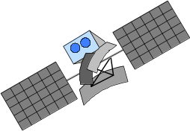
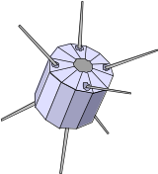





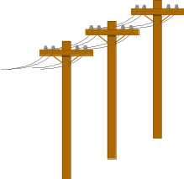
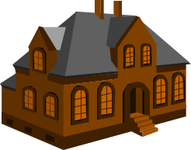
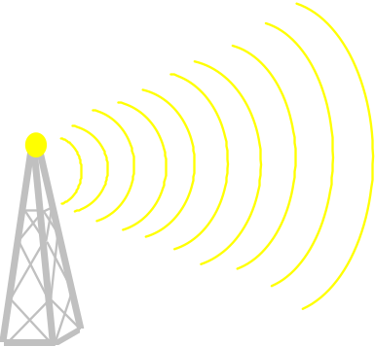
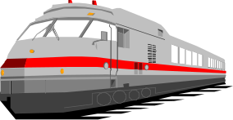
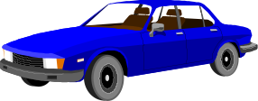

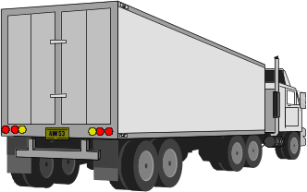
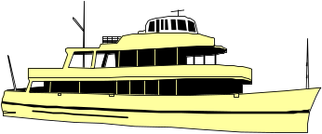

A multimedia world..in transition..
Copper to glass
Radio + Satellite + IR
Fixed to mobile
Robert Statica – Cybersecurity

Slide 43
Machines Overtake Mankind
100
% Network Traffic
75
Mankind
50
6Bn
Machines
Machines
25
20Bn
0
1980
1985
1990
1995
2000
2005
2010
2015

Slide 44
It’s not about $ - It is about time
Rate of change
Technology
Companies
Business
Society
People
Legal Systems
Governments
Time
Today

Slide 45
Everything will be in Cyberspace covered by a hierarchy of computers!
Cell
Body
Continent
Home
Region
Car
Building
Campus
World
Fractal Cyberspace: a network of … networks of … platforms
Robert Statica – Cybersecurity
Original by Gordon Bell
Notes:
26

Slide 46
Survival…..
“It is not the strongest of the species that survive, nor the most intelligent, but the one most responsive to change”
Charles Darwin

Slide 47
Thank You!

